Slide 1
Level 4/5 Group 4
Tom Simmons
Ben Reynolds
Ionut Ciobanu
Sam Clack

Slide 2
Phantasm
There is no escaping your past.

Slide 3
Plot Summary
The MC will experience a traumatic accident in the opening cut scene
The MC will fall into a coma, and ‘awaken’ in a nightmarish world
The MC’s goal is to escape from this coma and return to reality

Slide 4
Obscure Sorrows

Slide 5
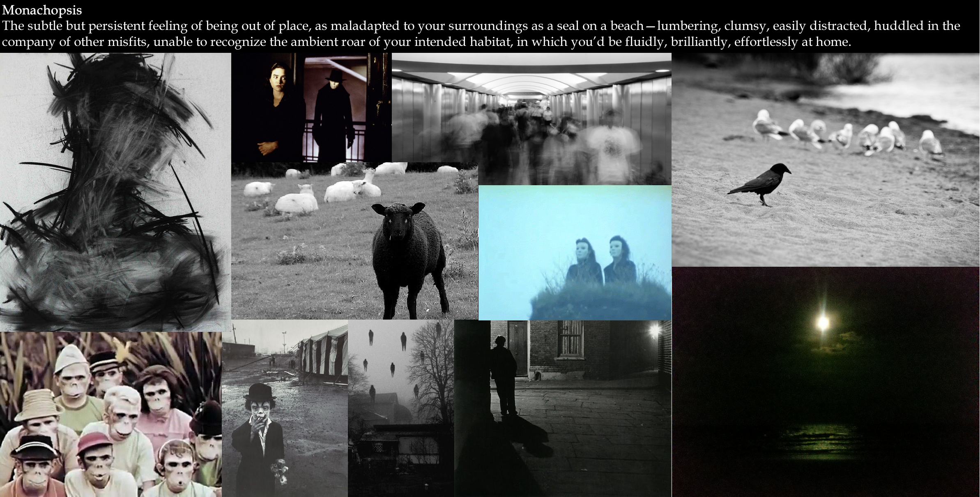

Slide 6
Monachopsis
The Player is thrown into a world that is completely new to him
The world is inhabited by unfamiliar beings
As the game progresses, the MC will notice subtle familiarities as he realises the world is in fact a product of his subconscious

Slide 7
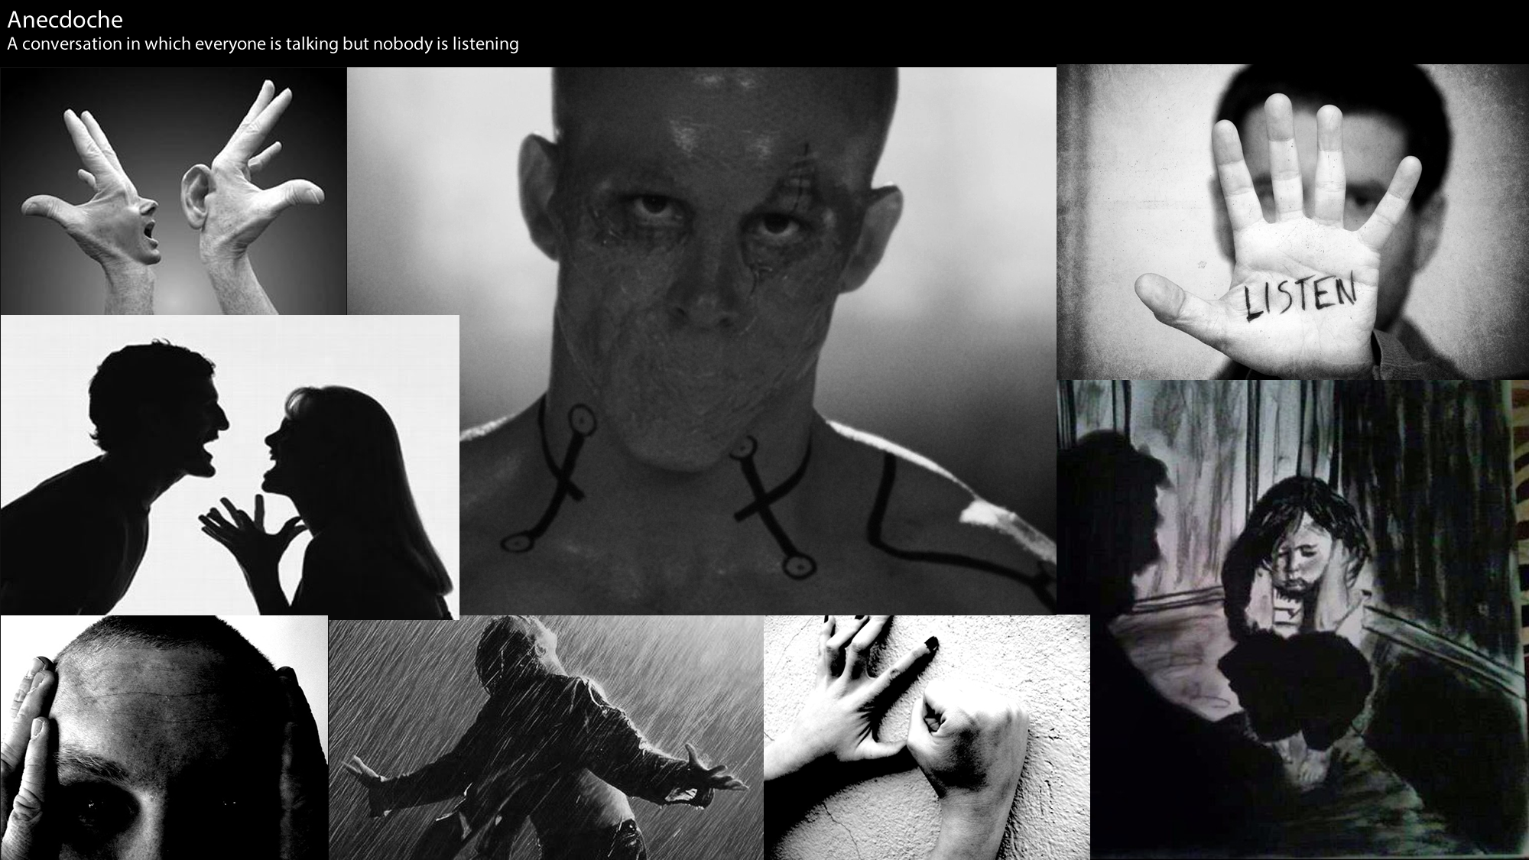

Slide 8
Anecdoche
The Player will hear whispers and muffled talking through the game’s levels.
These audio queues will help guide the Player through the levels and hint at solutions to the game’s puzzles.
The MC will later realise that these voices originate from his surroundings outside of his coma.

Slide 9
Target Audience
Males Aged 16-31

Slide 10
Target Platforms
PC
Xbox Arcade
Playstation Store

Slide 11
Game Mechanics
Twitch Movement
Audio Navigation
Puzzle Solving

Slide 12
Game Scope
_{Main Menu}
_{- Play}
_{- Controls / Help}
_{- Exit}
_{Levels}
_{- Level 1}
_{- Level 2}
_{- Level 3}
Audio
- Background Music
- SFX

Slide 13
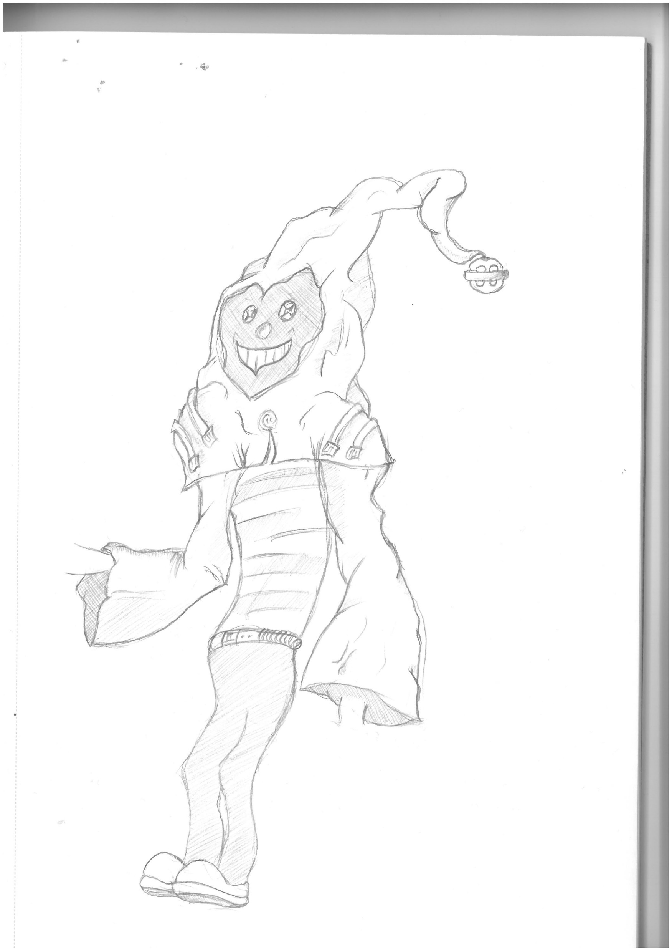
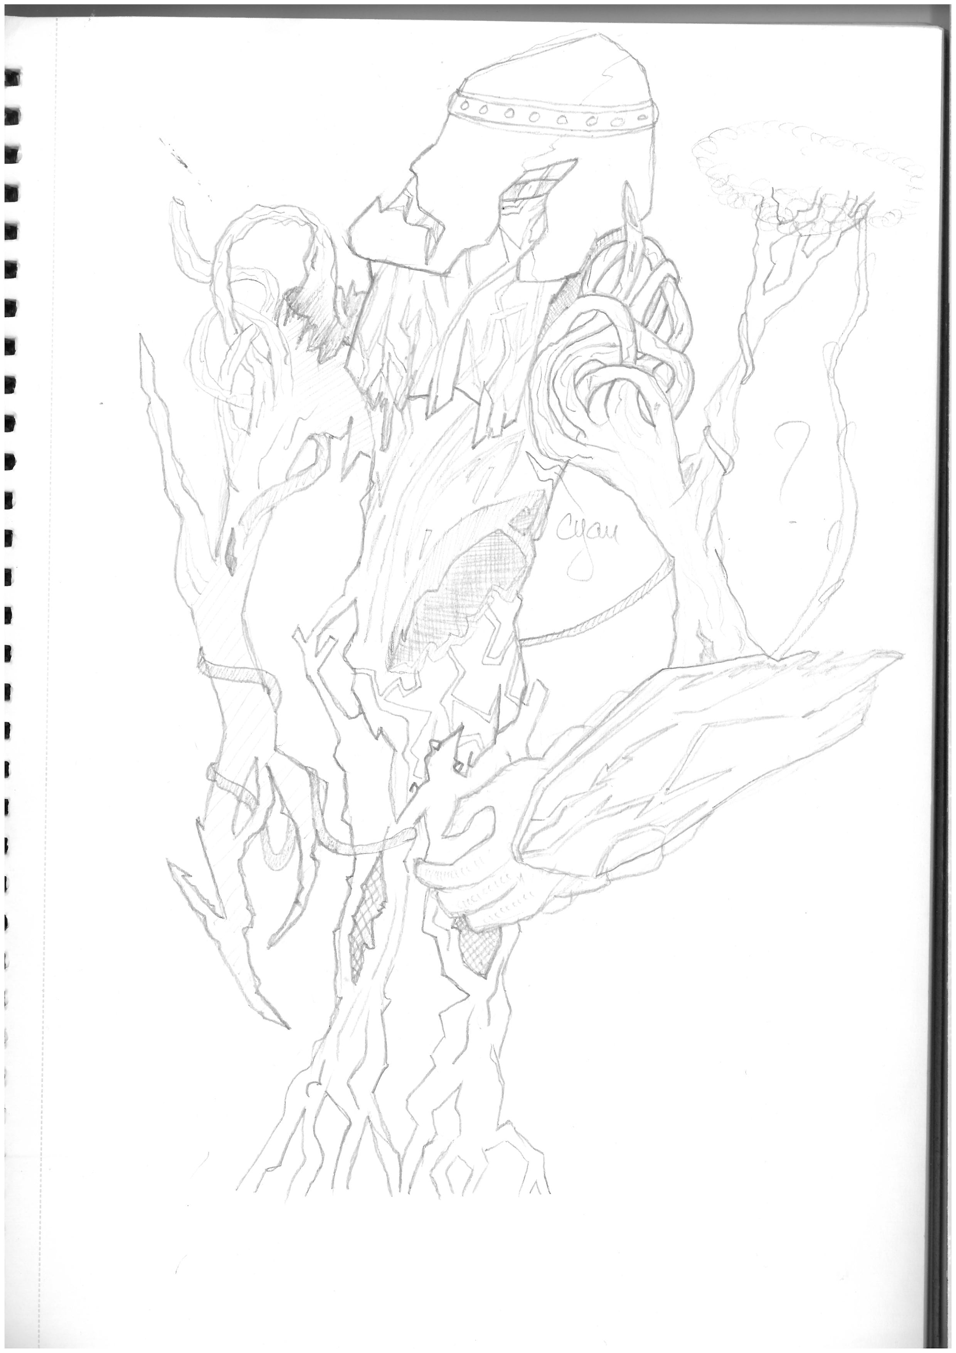
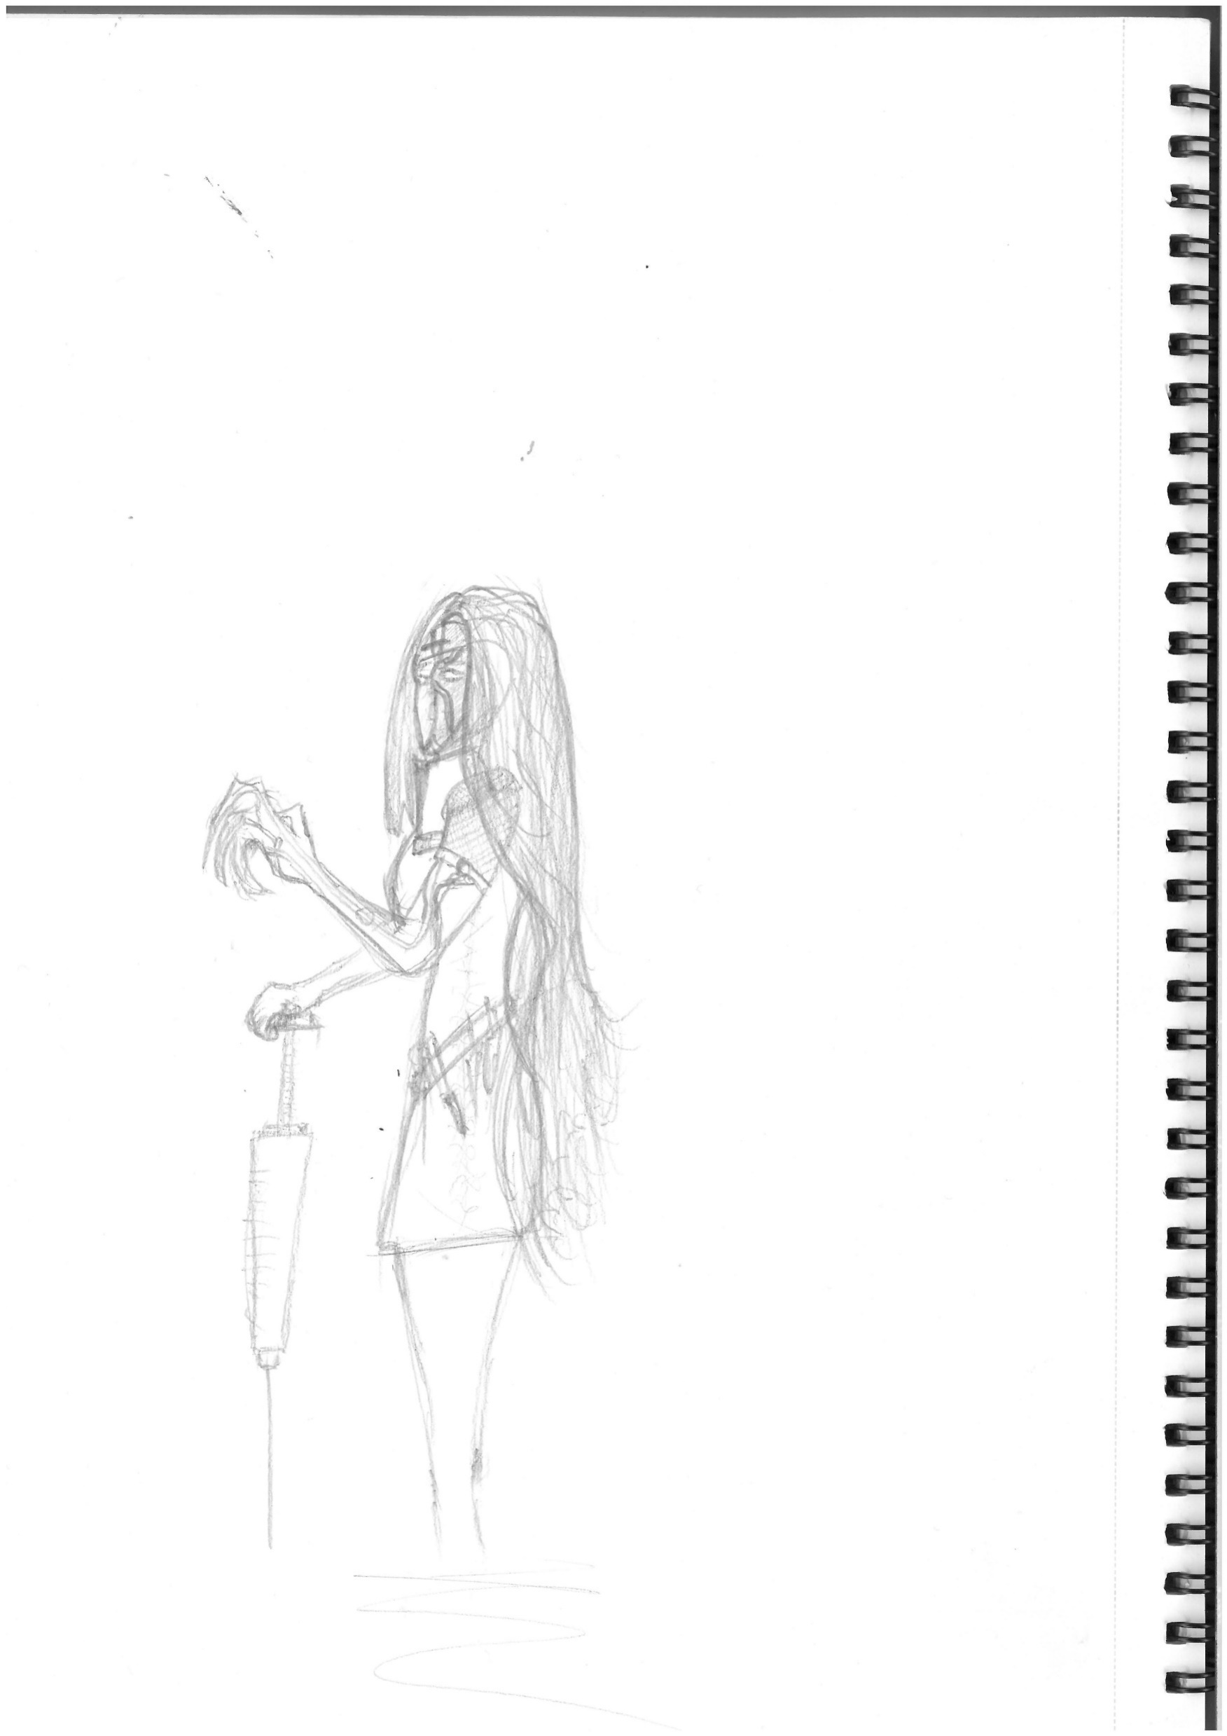
Protagonists

Slide 14
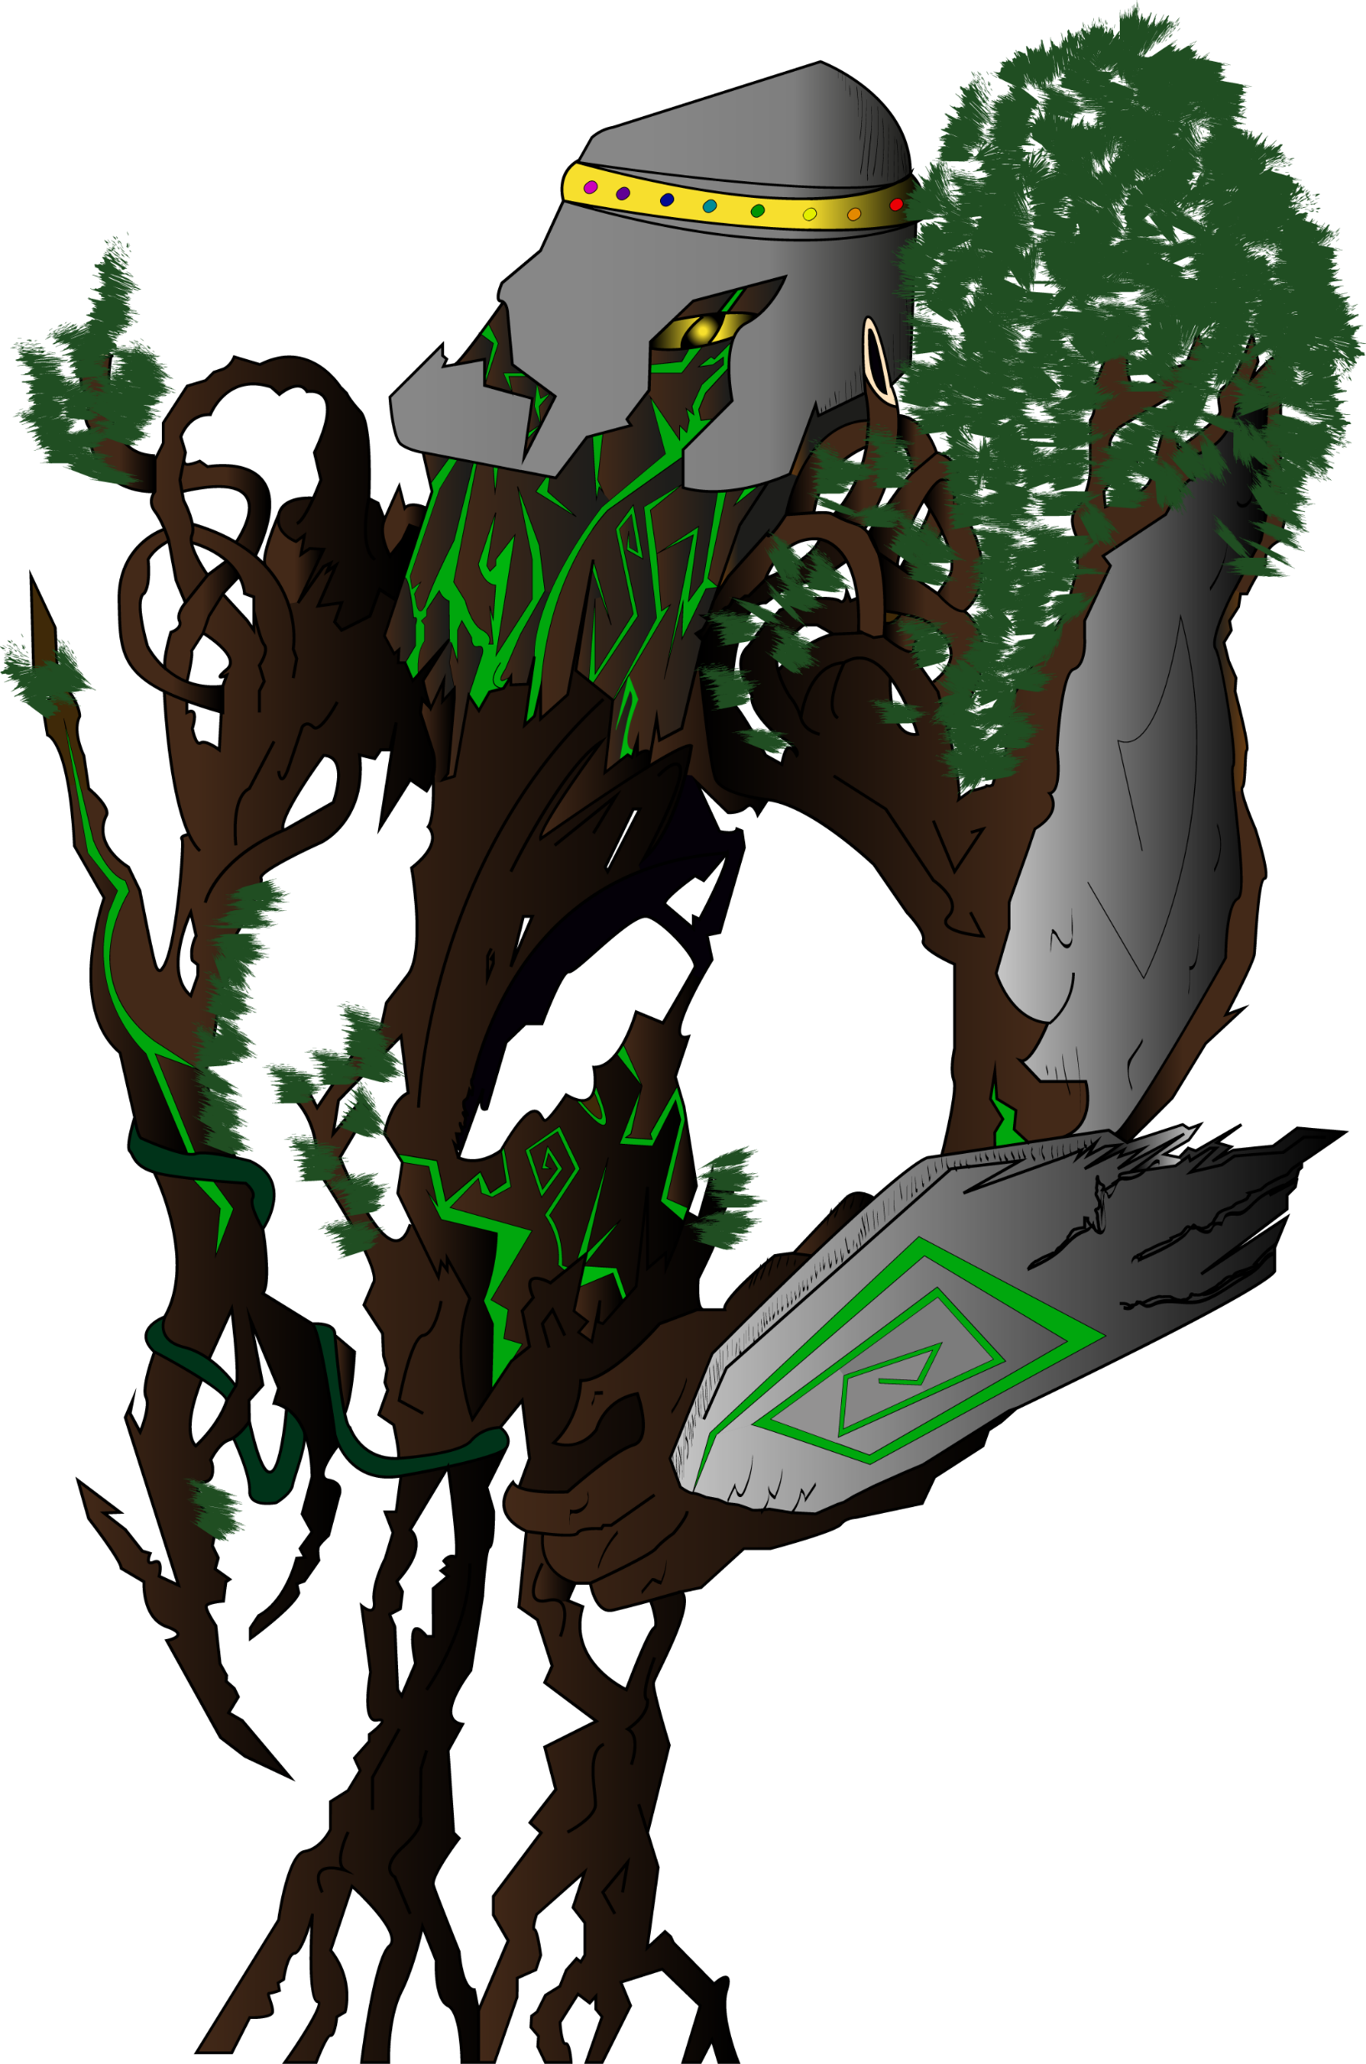
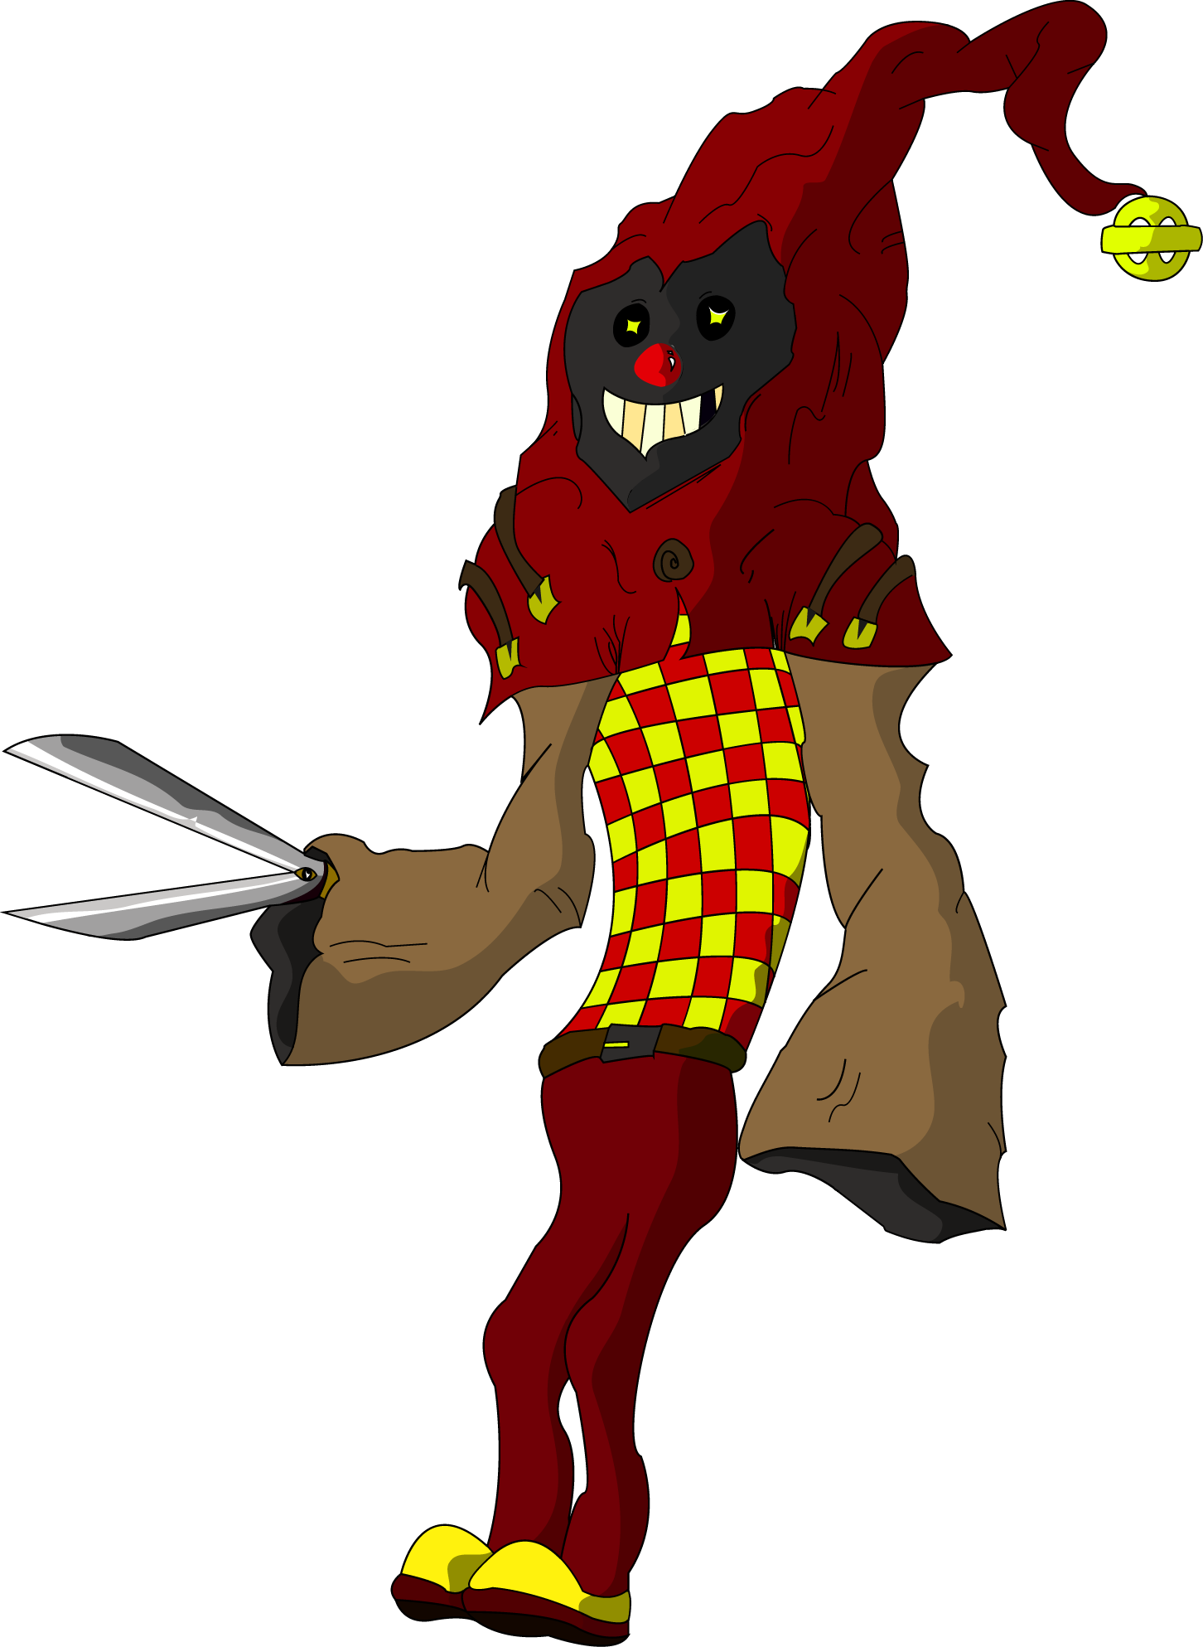
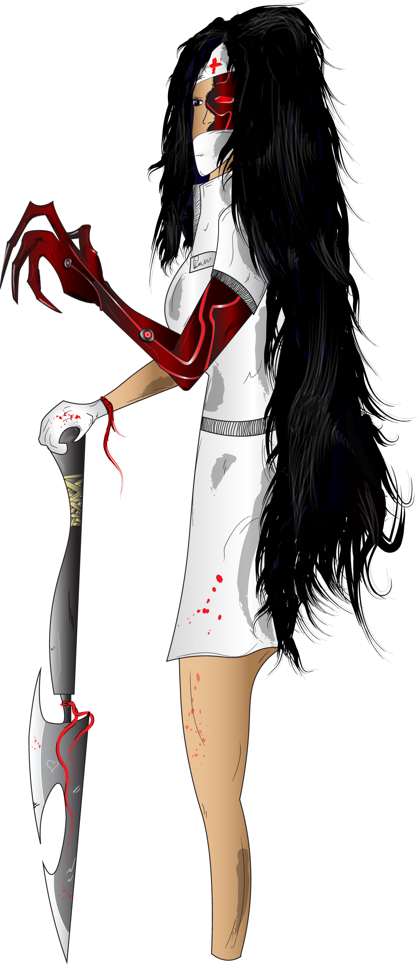
Protagonists

Slide 15







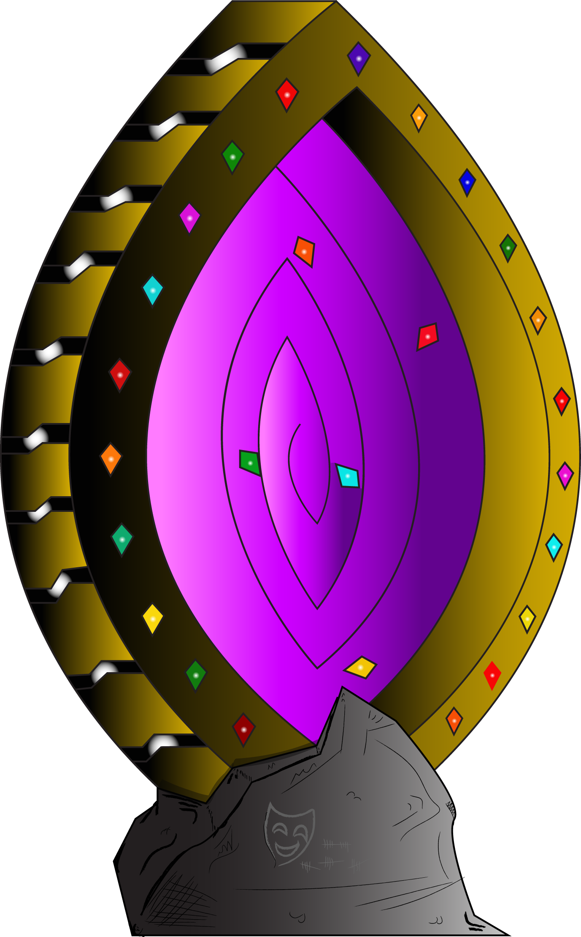
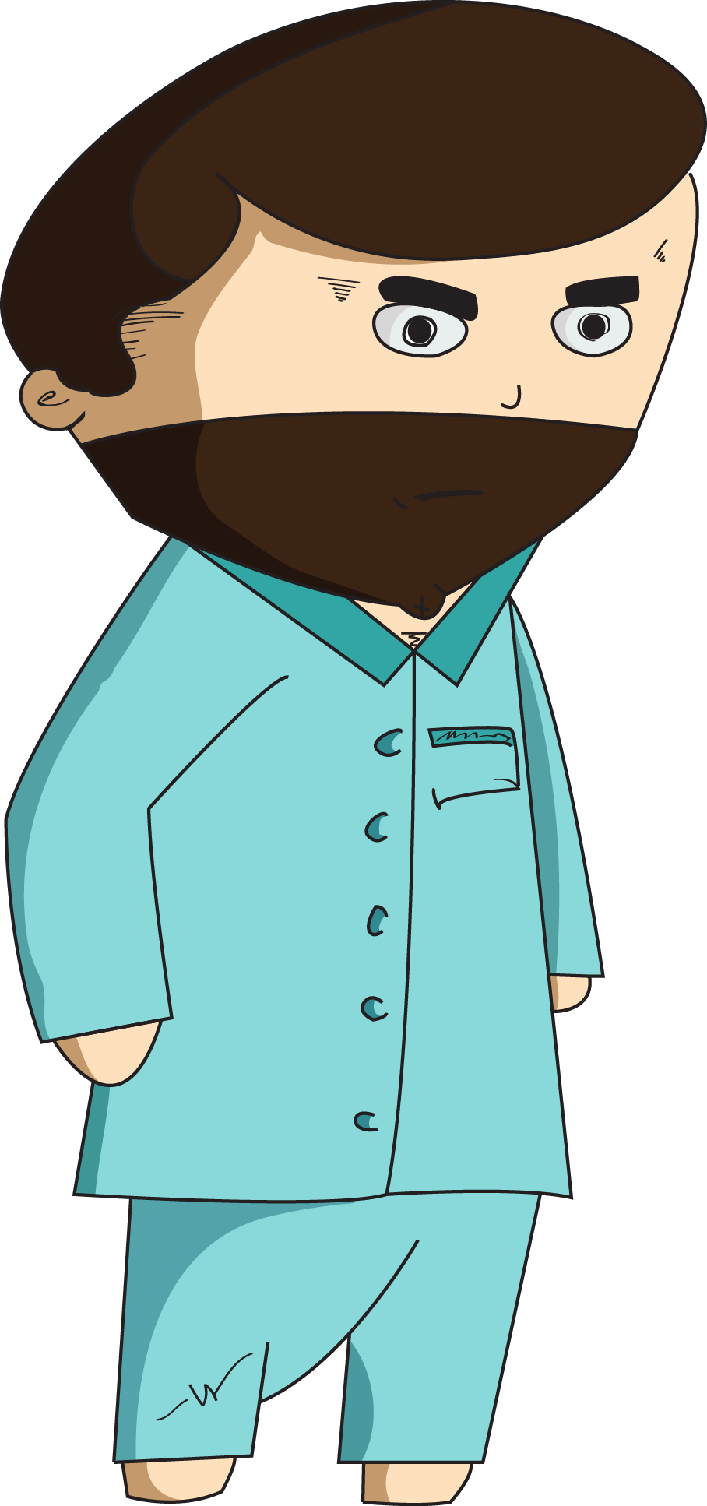

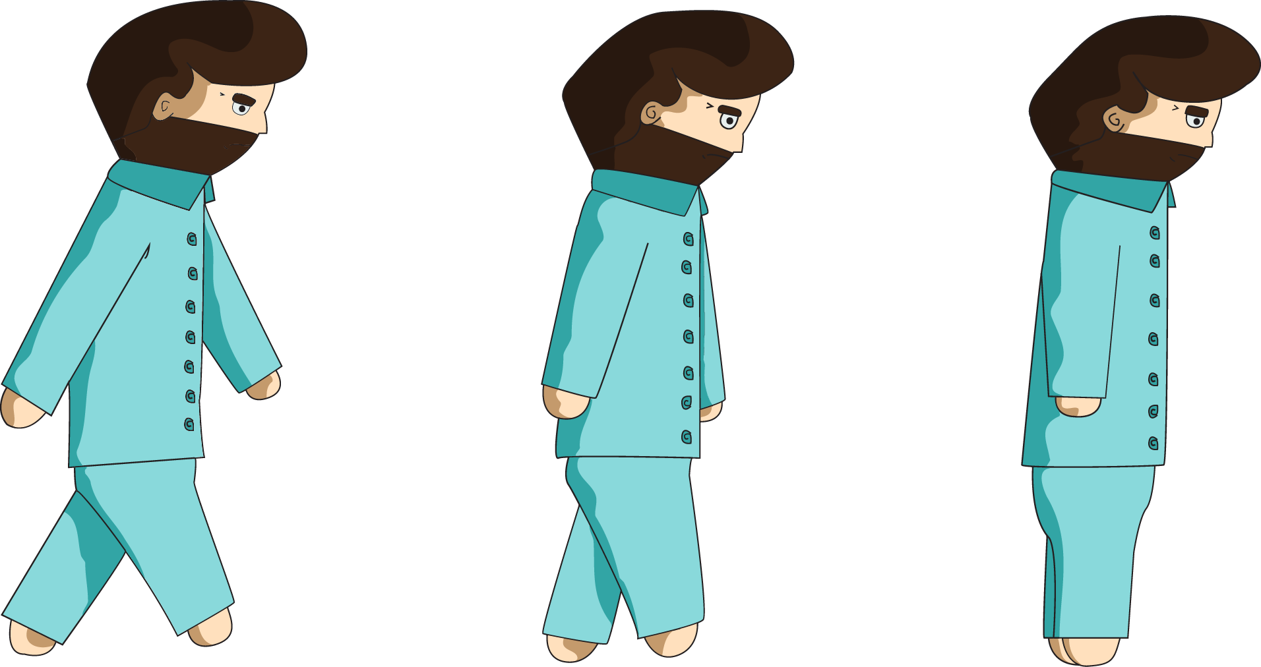







Game Assets

Slide 16
Gameplay Video

Slide 17
_{Management}

Slide 18
Emails Sent

Slide 19
Hours Logged

